Slide 1
Hourly Demand Prediction & Optimization Report

Slide 2
Contents
Introduction to the Challenge
Baseline Model
Improved Model
Best Model
Forecast for First week of September
Optimal Number of Taxis
References

Slide 3
Business Problem:
To predict the hourly demand for taxis in the Bronx area and determine the optimal number of taxis required to meet this demand.
Baseline Model
Build a simple baseline model to predict hourly demand
Best Model
Optimize your improved model to achieve the best possible performance.
Improved Model
Develop an improved model by incorporating additional features, refining your data preprocessing steps, or using more sophisticated algorithms
Forecasting
Optimization
Determine the optimal number of taxis required to meet the predicted hourly demand in the Bronx
Using your best model, forecast the hourly demand for taxis in the Bronx for the first week of September 2024.

Slide 4



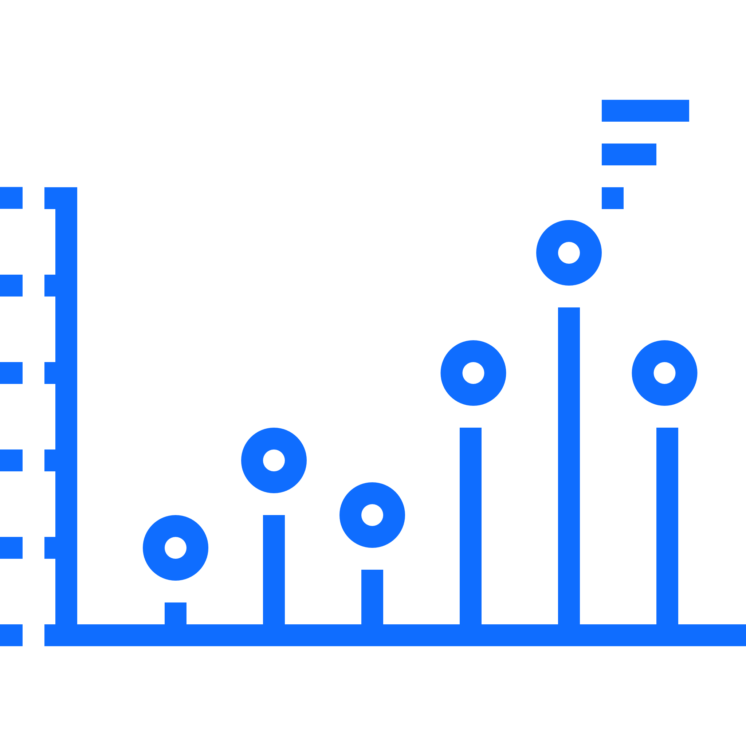
Baseline Model: Simple Moving Average is chosen as the Baseline Model
Data Cleaning and Processing
Feature Engineering
Model Development
Model Result and Performance
Import necessary Libraries like NumPy, Pandas, Scikit-learn
Convert date cols to datetime format
Convert Time zone(UTC) format in proper standard
Filter only for Bronx area using Location data
Aggregated demand by hour
Fill all the NANs
Drop unwanted columns
Add in new features to the data like day of week, month, weekend
Merge taxi details data after preprocessing with weather data to get in more features
Add lags for the demand(lag1,2,3) as features
Split the data intro features (X) and Target (y)
Split the Data into training (80%) and testing
Use Simple Moving Average as Baseline model with window size 3
Get the predicted demand
The Prediction aligns with the actuals.
Model is evaluated on 3 metrics:
MAE: 0.80
MSE:3.95
R-squared:0.92

Slide 5
Improved Model: Linear Regression proved better as an improved Model
Data Cleaning and Processing
Feature Engineering
Model Development
Model Result and Performance
Import necessary Libraries like NumPy, Pandas, Scikit-learn
Convert date cols to datetime format
Convert Time zone(UTC) format in proper standard
Filter only for Bronx area using Location data
Aggregated demand by hour
Fill all the NANs
Drop unwanted columns
Add in new features to the data like day of week, month, weekend
Merge taxi details data after preprocessing with weather data to get in more features
Add lags for the demand(lag1,2,3) as features
Split the data intro features (X) and Target (y)
Split the Data into training (80%) and testing
Use Linear Regreesion as improved model
Get the predicted demand
The Prediction aligns with the actuals.
Model is evaluated on 3 metrics:
MAE: 0.61
MSE:3.2
R-squared-0.94
Linear Regression performed better as error reduced from 0.81 to 0.61

Slide 6
Best Model: Lasso Regression proved best as a model in terms of model performance for demand prediction
Data Cleaning and Processing
Feature Engineering
Model Development
Model Result and Performance
Import necessary Libraries like NumPy, Pandas, Scikit-learn
Convert date cols to datetime format
Convert Time zone(UTC) format in proper standard
Filter only for Bronx area using Location data
Aggregated demand by hour
Fill all the NANs
Drop unwanted columns
Add in new features to the data like day of week, month, weekend
Merge taxi details data after preprocessing with weather data to get in more features
Add lags for the demand(lag1,2,3) as features
Split the data intro features (X) and Target (y)
Split the Data into training (80%) and testing
Use Lasso and Ridge Regression as model to compare
Get the predicted demand
The Prediction aligns with the actuals.
Model is evaluated on 3 metrics:
MAE: 0.60
MSE:3.2
R-squared-0.94
Lasso Regression has the lowest MAE and MSE, and the highest R-squared value among the models compared

Slide 7
Best Model: XG Boost proved best as a model in terms of forecasts for demand prediction
Data Cleaning and Processing
Feature Engineering
Model Development
Model Result and Performance
Import necessary Libraries like NumPy, Pandas, Scikit-learn
Convert date cols to datetime format
Convert Time zone(UTC) format in proper standard
Filter only for Bronx area using Location data
Aggregated demand by hour
Fill all the NANs
Drop unwanted columns
Add in new features to the data like day of week, month, weekend
Merge taxi details data after preprocessing with weather data to get in more features
Add lags for the demand(lag1,2,3) as features
Split the data intro features (X) and Target (y)
Split the Data into training (80%) and testing
Use XGBoost as model to compare
Get the predicted demand
The Prediction aligns with the actuals.
Model is evaluated on 3 metrics:
MAE: 1.35
MSE:11.1
R-squared-0.80

Slide 8
Forecasting for the first week of September 2024 : Using Lasso Regression and XGBoost
Data Cleaning and Processing
Feature Engineering
Model Development
Model Result and Performance
Import necessary Libraries like NumPy, Pandas, Scikit-learn
Convert date cols to datetime format
Convert Time zone(UTC) format in proper standard
Filter only for Bronx area using Location data
Aggregated demand by hour
Fill all the NANs
Drop unwanted columns
Add in new features to the data like day of week, month, weekend
Add rolling mean as feature
Merge taxi details data after preprocessing with weather data to get in more features
Add lags for the demand(lag1,2,3) as features
Split the data intro features (X) and Target (y)
Split the Data into training (80%) and testing
Use Lasso to predict for first week
Get the predicted demand
Results for the prediction (Forecast_Sept_firstweek.csv)
Model is evaluated on 3 metrics:
MAE: 0.60
MSE:3.2
R-squared-0.94

Slide 9
Optimal Number of Taxis
Assumptions:
Operational Constraints:
Average Trip Duration
Taxi Availability
Assume the average trip duration for a taxi ride in the Bronx is 30 minutes (0.5 hours). This means that, on average, a taxi can complete two trips per hour.
Assume that a taxi is available and ready to accept a new fare immediately after completing the previous trip.
Demand Prediction
We already have the hourly demand forecast for the first week of September using the Lasso model. Let’s assume this is an accurate prediction of customer demand.
Taxi Shift Length
Safety Buffer
Taxis operate in 12-hour shifts, so the availability of each taxi is 12 hours a day
Add a buffer of 10% to account for unpredictable events such as traffic, delays, or downtime.
Cost Considerations:
For this analysis, we'll assume that the costs of increasing the taxi fleet are proportional to the number of taxis deployed. The goal is to meet the demand while minimizing under-utilization (idle taxis).

Slide 10
Optimal Number of Taxis
Results: Found the Optimal number of Taxis using Lasso Model Predicted Demand
Please find the results in Optimal_taxis.csv
Maximum number of Taxis required is 14 while minimum is 2.

Slide 11
References:
Chicco, D., Warrens, M.J. & Jurman, G. (2021). The coefficient of determination R-squared is more informative than SMAPE, MAE, MAPE, MSE and RMSE in regression analysis evaluation. PeerJ Computer Science, 7, e623. Available from: https://doi.org/10.7717/peerj-cs.623
Tibshirani, R. (1996). Regression Shrinkage and Selection via the Lasso. Journal of the Royal Statistical Society: Series B (Methodological), 58(1), pp. 267-288.
Hyndman, R.J. & Athanasopoulos, G. (2018). Forecasting: Principles and Practice. OTexts. Available from: https://otexts.com/fpp3/
Pedregosa, F. et al. (2011). Scikit-learn: Machine Learning in Python. Journal of Machine Learning Research, 12, pp. 2825-2830. Available from: https://scikit-learn.org

Slide 12
Thank you!

